Slide 1
Come in Quietly
Take out your whiteboard & pen.
Take out a piece of paper, pen or pencil.
Have your chromebook ready to use but do not open yet.
Immigration

Slide 2

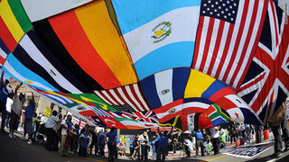
Immigration! What is it and why do it?
Objective
Obj: Identify and describe different types of immigration.
Learning Targets:
1. I will be able to identify and explain the difference between an immigrant, emigrant, and migrant.
Standard 8.6.3: List the reasons for the wave of immigration from Northern Europe to the United States and describe the growth in the number, size, and spatial arrangements of cities (e.g., Irish immigrants and the Great Irish Famine.)
CCSS.ELA-LITERACY.RH.6-8.4:Determine the meaning of words and phrases as they are used in a text, including vocabulary specific to domains related to history/social studies.

Slide 3
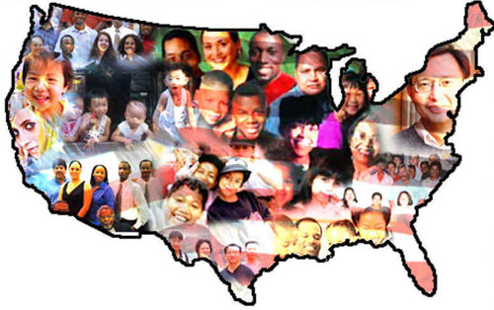
Prior Knowledge
Prior Knowledge
You already know that people in America are different ages, sizes, races and religions.
How did America end up with so many different types of people?

Slide 4
Concept - Migration
Concept
Migration is a common activity that involves the movement of individuals from one place to another that can be seen in a number of animal groups. Even though most of us think of a flock of birds when we hear migration, it is important to note that humans have not excluded themselves from this fundamental phenomenon and continue to migrate to this day.
The migration, or movement, of human beings can in some cases be classified into two more specific subcategories: immigration and emigration.
Thousands of people each year make the decision to emigrate (to leave one’s nation) in order to immigrate (to enter and establish oneself) to another nation.
Think about the main idea of this reading then be ready to share your answer and evidence.
Partner A share with Partner B “The main idea of this reading is _______ because _______”.
Partner B responds to Partner A “I agree or disagree the main idea is _____ because ____”.

Slide 5
Closure
What is the topic of our first unit?
Explain migration.

